Slide 1
Airline Passenger Satisfaction
By: Michael Holthouser

Slide 2
Overview
Business Understanding
Stakeholder
Business Question
Data Understanding
Modeling
Best Model
Evaluation Metric
Feature Visualizations
Recommendations
Future Work

Slide 3
Business Understanding
Stakeholder:
Explorer Airlines
Business Problem:
Explorer Airlines has tasked me to provide prediction analysis on their passenger's satisfaction levels.
Business Question:
What key features do passengers find most important while traveling?

Slide 4
Data Understanding
Gender: male or female
Customer type: regular or non-regular airline customer
Type of travel: the purpose of the passenger's flight (personal or business travel)
Class: business, economy, economy plus
Flight distance: The flight distance of this journey
Inflight wifi service: satisfaction level with Wi-Fi service on board (1-5)
Ease of Online booking: online booking satisfaction rate (1-5)
Food and drink: food and drink satisfaction level (1-5)
Online boarding: satisfaction level with online boarding (1-5)
Seat comfort: seat satisfaction level (1-5)
Inflight entertainment: satisfaction with inflight entertainment (1-5)
On-board service: level of satisfaction with on-board service (1-5)
Leg room service: level of satisfaction with leg room service (1-5)
Baggage handling: level of satisfaction with baggage handling (1-5)
Checkin service: level of satisfaction with checkin service (1-5)
Inflight service: level of satisfaction with inflight service (1-5)
Cleanliness: level of satisfaction with cleanliness (1-5)
Satisfaction: Airline satisfaction level(Satisfaction, neutral or dissatisfaction).

Slide 5
Modeling
Best Model: XGBoost Classifier
96% F1-Score – Neutral or Dissatisfied
97% F1-Score – Satisfied
AUC = 96%
Evaluation Metric:
F1-Score is the harmonic mean of recall and precision.
AUC tells how well the model performs.
Important Features:
Customer type: Returning customer
Leg room
Gender female
Inflight entertainment
Check–in service

Slide 6
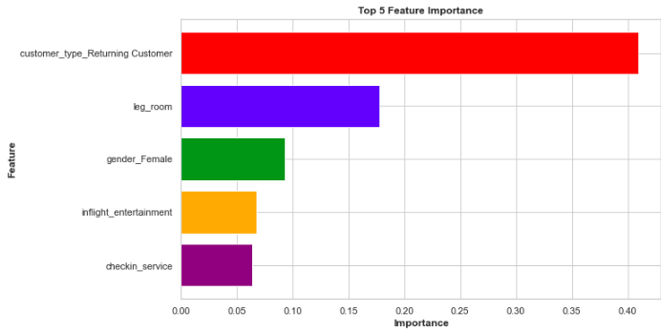
Important Features
Top 5 Important Features:

Slide 7
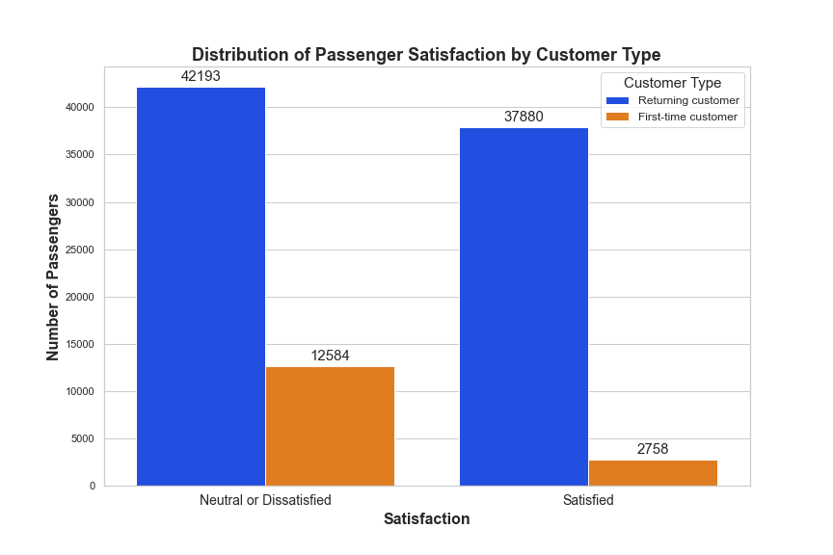
Returning Customers
There were significantly more returning customers than first-time customers in the dataset.
Recommendations:
Offer loyalty programs or rewards to returning customers.
Offer special perks or benefits to returning customers.
Priority boarding.
Free baggage check.
Provide personalized experiences to returning customers.
Offer special promotions based on their past behavior.

Slide 8
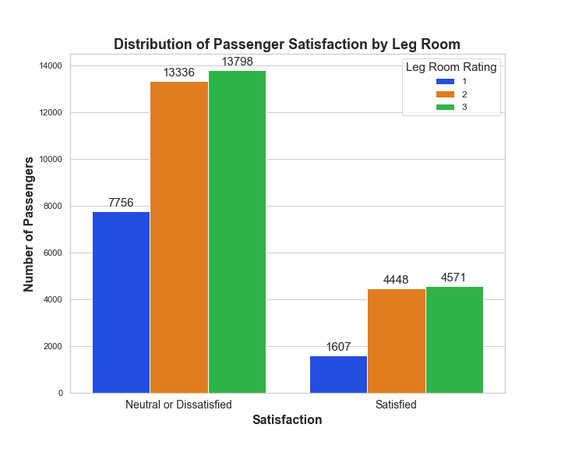
Leg Room
Uncomfortable seats mean unhappy passengers.
Recommendations:
Increase leg room
Comfortable experience
Customer loyalty
Repeat business

Slide 9
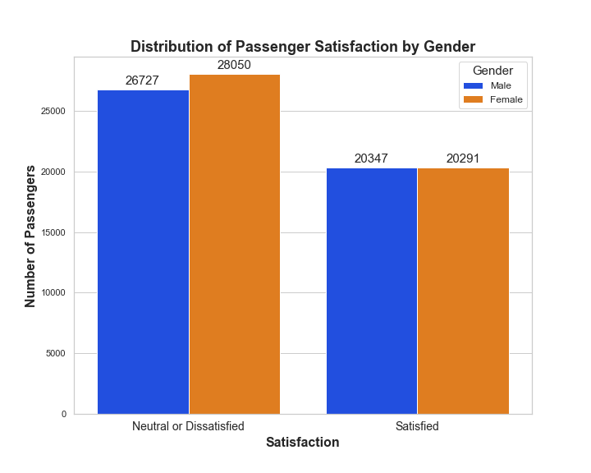
Gender Female
The female gender is more impactful than the male gender for this model.
There are more females than males in this dataset.
Recommendations:
Ensure that their services are inclusive and welcoming to all genders.
Any biases in data collection need to be addressed.
Investigate whether there are any specific areas where female passengers have unique concerns or needs.

Slide 10
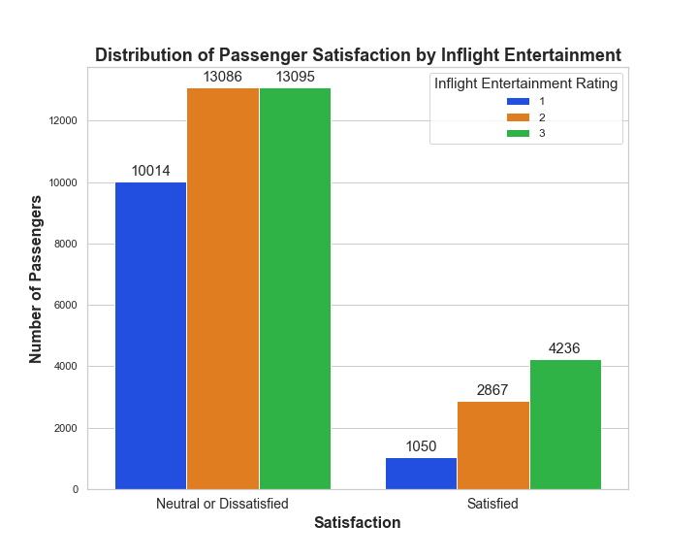
Inflight Entertainment
Poor inflight entertainment will cause passengers to leave neutral or dissatisfied.
Recommendations:
Charging ports for every seat.
Multilingual content.
International passengers
Updating the selection of movies and tv shows frequently.
Have the UX team explore innovative approaches to keep the entertainment app user- friendly.
Personalized experience.
Allow passengers to save their preferences.

Slide 11
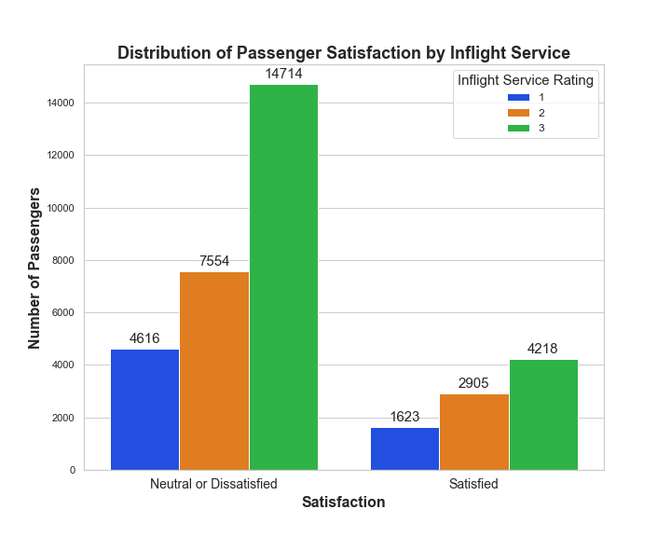
Check-in Service
Passengers that are unhappy and frustrated with the check-in service are likely to be dissatisfied.
Recommendations:
Work with the UX team to ensure the online check-in service is as user friendly as possible.
Improve staff training.
Ensure that staff are capable of handling all situations to help expedite the check-in process.
Staff accordingly.
Ensure there is enough staff to assist passengers during the busy travel hours and days.
Provide an ample amount of self-service kiosks at the airport for customers to check-in and print boarding passes.

Slide 12
Future Work
After adjustments have been made from the recommendations provided, perform another analysis to see if customer satisfaction has improved.
Try different models with different tuning techniques to see if they perform better.
Collect additional data: The dataset used in this analysis only includes a single airline. Collecting data from multiple airlines may provide more insights and make the results more generalizable.

Slide 13


Thank you
Michael Holthouser
Mholthouser.co@gmail.com
https://github.com/MHolthouser1024/Airline-Passenger-Satisfaction.git

